Slide 1
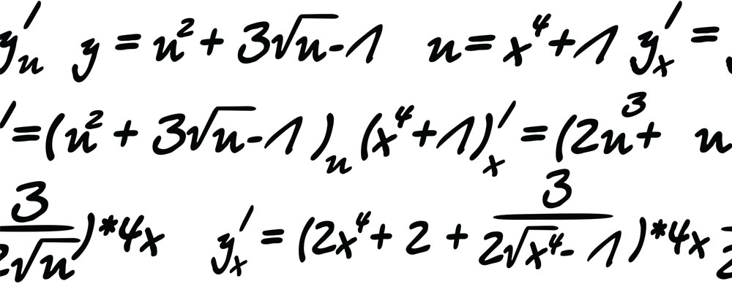

My Algebra
Interactive Notebook
Name:
Class:
Teacher:
Term 2 Semester 1

Slide 2

Lesson Objectives
Explain and understand what a commutative law is

Slide 3
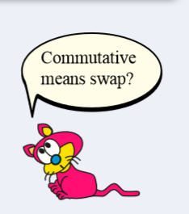
24
7
30
Topic: Commutative Law
Date
EQ – Which operations are commutative?
What is commutative law?
An operation is commutative if changing the order of the numbers does not change the final result
When you finish writing this down add this key word to your glossary!

Slide 4
1
2
3
2
3
4
5
1
1
5
+
3
=
3
6
7
8
1
2
+
3
5
=
8
8
8
3
7
5
2
6
4
1
5
4
Notes:
The animations take a little bit of time but are very good visual aids for this.

Slide 5
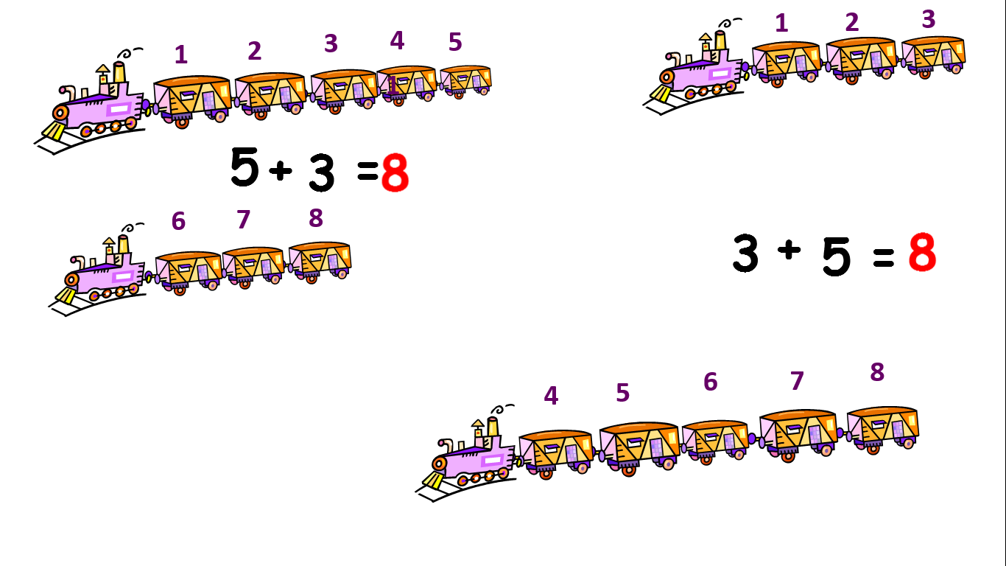
Addition is Commutative!
Notes:
Students do not need to write this down yet they will add it to the table in their notes after subtraction

Slide 6

Subtraction
We start with 5 apples
We start with 3 apples
Take away 3 apples
Take away 5 apples
2 apples left
We don’t have enough apples = -2
Subtraction Is Not Commutative

Slide 7
24
7
30
Topic: Commutative Law
Date
EQ – Which operations are commutative?
Operation | Addition | Subtraction | Multiplication | Division
Commutative | YES | NO
Example | 5 + 3 = 8 3 + 5 = 8 | 5 - 3 = 2 3 - 5 = -2
Which operations are commutative?
Notes:
Students to create table and record the information in their notes, encourage the students to create their own examples

Slide 8


Multiplication
5 groups of 2
2 groups of 5
1st group
1st group
2nd group
2nd group
3rd group
4th group
$$2×5=10$$
5th group
Multiplication Is Commutative
10 apples total
$$5×2=10$$
10 apples total

Slide 9
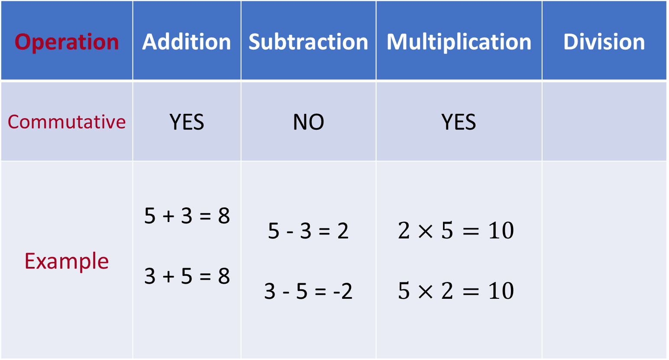
24
7
30
Topic: Commutative Law
Date
EQ – Which operations are commutative?
Operation | Addition | Subtraction | Multiplication | Division
Commutative | YES | NO | YES
Example | 5 + 3 = 8 3 + 5 = 8 | 5 - 3 = 2 3 - 5 = -2 | $$2×5=10$$ $$5×2=10$$
Which operations are commutative?

Slide 10


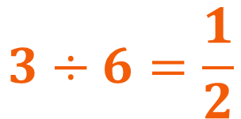
Division
6 lollies
We can divide them into 3 groups
3 lollies
We can divide them into 6 groups
2 lollies in each group
½ lolly in each group
$$6÷3=2$$
$$3÷6=\frac{1}{2}$$
Division Is NOT Commutative

Slide 11
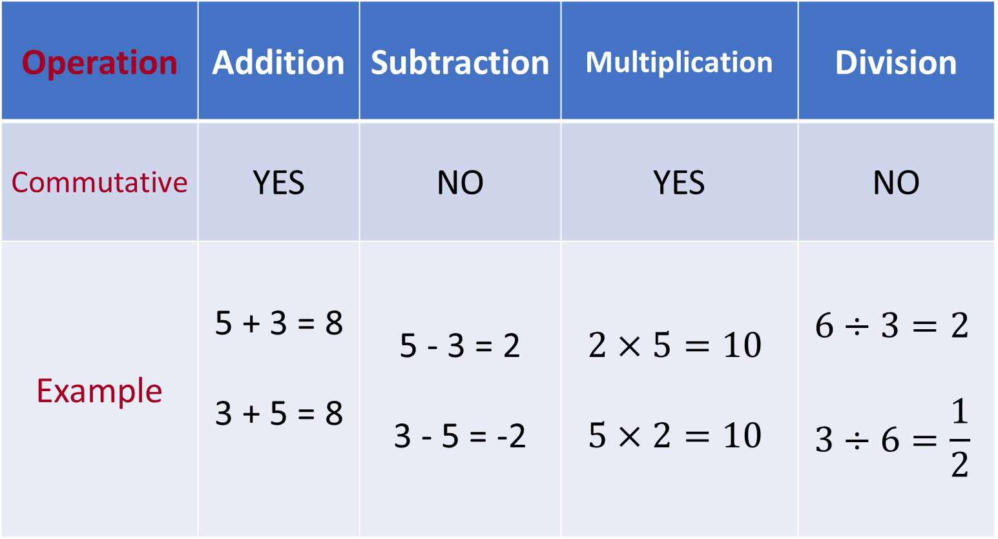
24
7
30
Topic: Commutative Law
Date
EQ – Which operations are commutative?
Operation | Addition | Subtraction | Multiplication | Division
Commutative | YES | NO | YES | NO
Example | 5 + 3 = 8 3 + 5 = 8 | 5 - 3 = 2 3 - 5 = -2 | $$2×5=10$$ $$5×2=10$$ | $$6÷3=2$$ $$3÷6=\frac{1}{2}$$
Which operations are commutative?
Notes:
If students are still finishing the table write on board information from next slide:
Once your table is complete and done neatly please complete Task 7.5 (Page 92). And then complete your summary

Slide 12
Task Side
Once your table is complete and done neatly please complete Task 7.5 (Page 92)
And then complete your summary

